Slide 1


TEAM ID5
Created By: DJOUDI Idris
BENSAID Marouane
BOUALEM Yacine
BOUSBAINE Abdelaziz
Supervisor: BOUCHEKIR Redouane
University of Science and Technology Houari Boumediene

Slide 2

Table of Contents
Introduction
What is ICT?
Definition,
Importance of ICT in Modern Society.
Categories of ICT Technologies
Communication Technologies.
Google Services in ICT
Google Workspace.
Educational Tools.
Microsoft Tools in ICT
Microsoft Office:
Word
Excel
Power points
Introduction to Git and GitHub
What is Git?
What is GitHub?
Case Studies & Example
How ICT Improves Daily Work.
Real-World Applications.
Conclusion

Slide 3
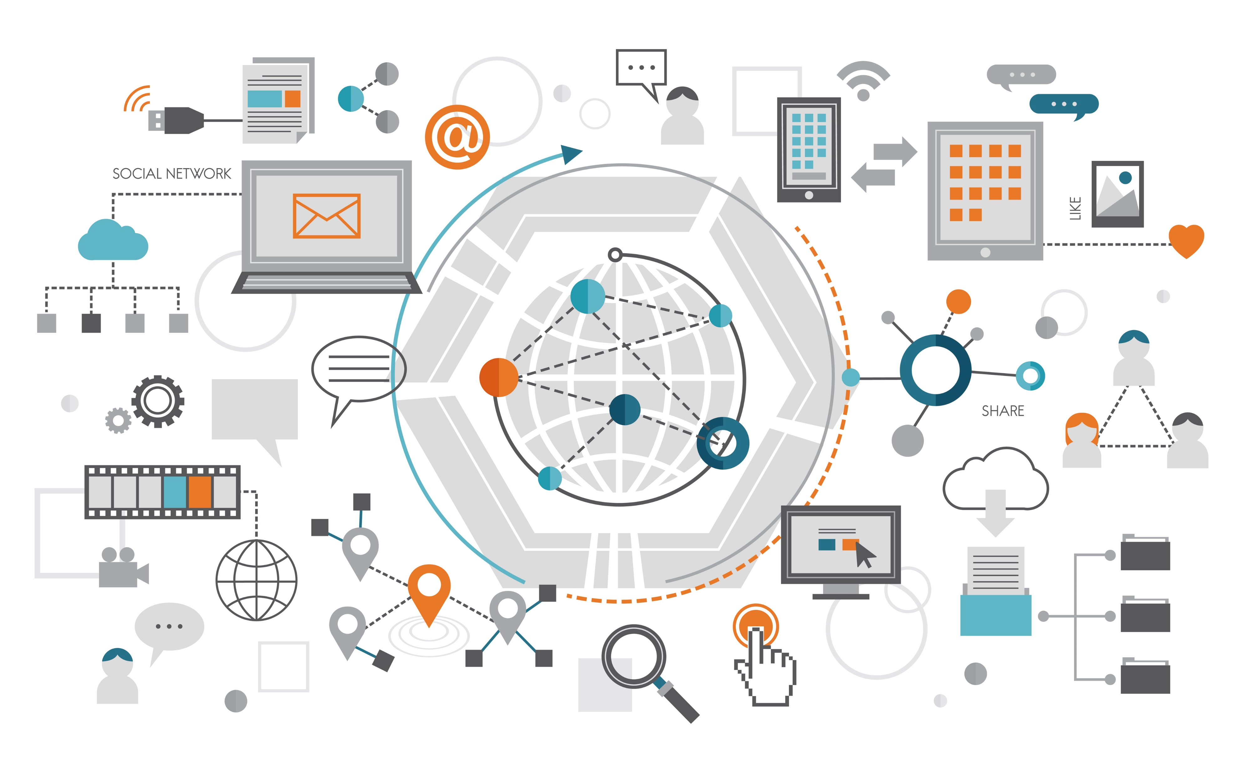
Introduction
Information and Communication Technologies (ICT) have transformed communication, work, and information sharing in the digital age. They include tools and platforms that support communication, collaboration, information management, and software development. Major companies like Google and Microsoft provide widely used services such as cloud storage, productivity tools, and collaboration platforms. Technologies like GIT and GitHub are essential for software development, enabling version control and teamwork. ICT also encompasses real-time communication technologies, which support instant messaging, voice and video calls, and are vital for remote work and global collaboration.

Slide 4
What Is ICT?
Definition
ICT, or Information and Communication Technology, is an umbrella term that includes all technologies used to handle information and aid communication.
It is often considered an extended synonym for IT (Information Technology), but ICT focuses more specifically on the role of unified communications and the integration of telecommunications (telephone lines and wireless signals) and computers.
Information: The data being processed, stored, or retrieved (videos, text, numbers, images).
Communication: The transfer of information between people or systems (emails, video calls, broadcasting).
Technology: The hardware and software used to perform these tasks.
The Three Core Elements:

Slide 5
Importance of ICT in Modern Society
economic growth and business transformation:
Digital Economy
Remote & Hybrid Work
Data-Driven Decisions
social and personal life:
Instant Global Communication
Information Access
Governance:
Efficiency in Public Services
Healthcare:
Remote Diagnosis
Health Monitoring
Electronic Health Records (EHR)

Slide 6
Categories of ICT Technologies:
Communication Technologies:
Technology | Best Use Case | Impact
5G / 6G | Smart Cities & VR | Real-time Lag-free connectivity.
Satellites | Rural & Remote Areas | Global internet coverage.
Fiber Optics | National Infrastructure | High-capacity, stable data flow.
IoT | Smart Homes & Factories | Automation and data monitoring.

Slide 7
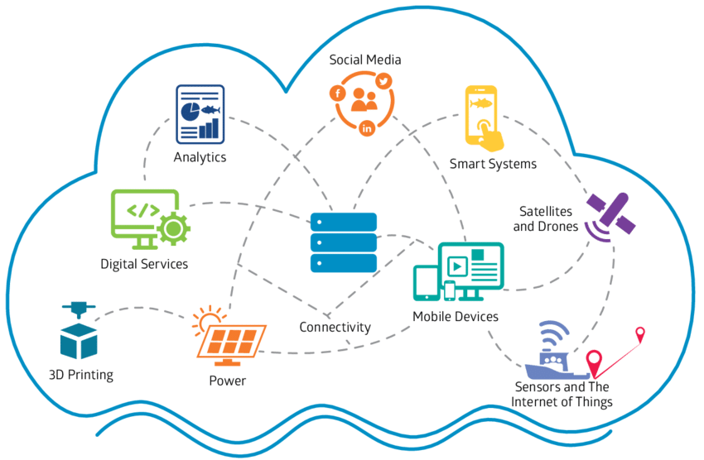
Why Communication Technologies are Vital
Global Collaboration
Instant Access to Information
Emergency and Disaster Response
Economic Efficiency

Slide 8
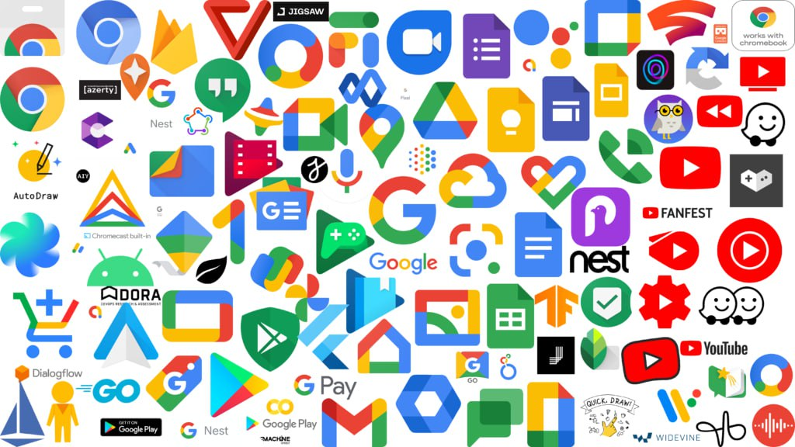
Google Services in ICT
Why Google Services are Essential to ICT
Google Workspace is an integrated suite of cloud-based productivity and collaboration tools developed by Google. It serves as a centralized digital ecosystem designed to streamline workflows, enhance communication, and foster real-time collaboration within teams and organizations.
The core elements of Google Workspace include:
Ubication Hub: Gmail Google Meet for and Google Chat
Collaborative Content Creation: Google Docs, Sheets, and Slides
Centralized Storage & File Management: Google Drive
Scheduling & Organization: Google Calendar
Security & Administrative Control:, multi-factor authentication and an Admin Console
Feature | Importance in ICT
Accessibility | Most services are free or low-cost, bridging the "Digital Divide."
Interconnectivity | All Google services are linked via one account, creating a seamless "Ecosystem."
Big Data | Google’s ability to process massive amounts of data helps in research, marketing, and science.
Education | Google for Education (Classroom) has become the standard for digital learning worldwide.

Slide 9
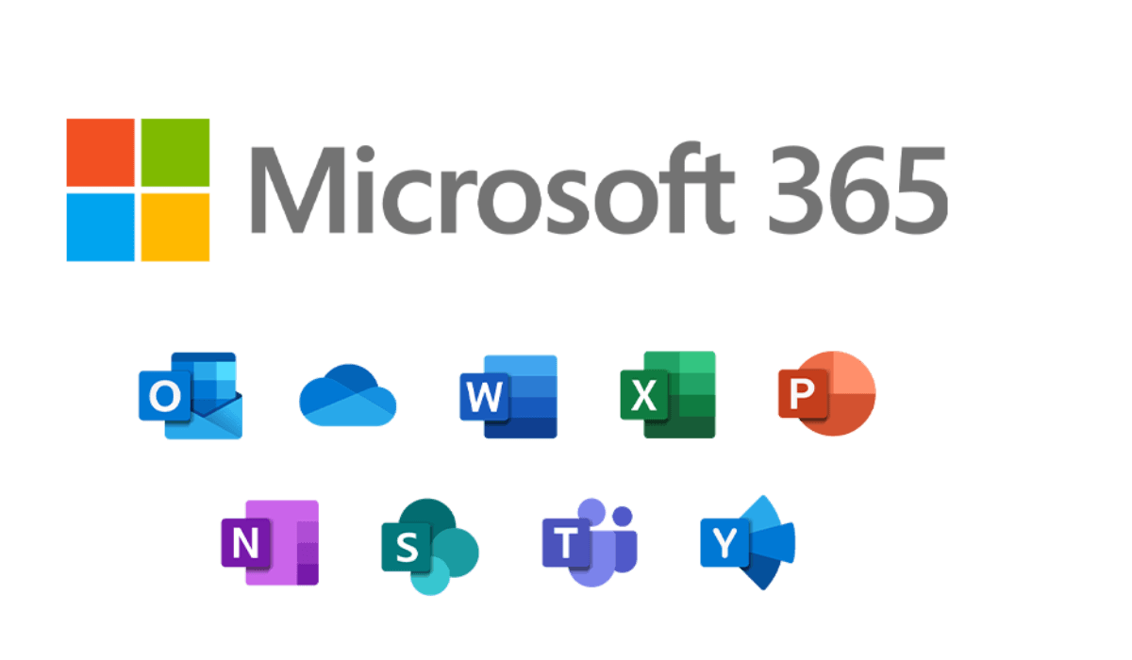




Microsoft Tools in ICT
Microsoft Office provides a complete set of professional tools that work together to produce high-quality output. Each application is designed for a specific purpose while contributing to an integrated ecosystem.
The primary applications:
Microsoft Word
Word is the main tool for creating and formatting professional documents, it is essential for reports, letters, resumes, and academic papers.
Microsoft Excel
Excel is used for organizing, calculating, and analyzing numerical data, it supports financial analysis, statistics, and data-driven decision-making.
Microsoft PowerPoint
PowerPoint focuses on visual presentations to help users communicate ideas clearly and effectively to an audience.
Microsoft Outlook
Outlook is a professional information manager that integrates email, serving as a central communication hub for organizations.
Microsoft Office is a comprehensive suite of desktop and cloud applications designed to facilitate professional document creation, data management, and visual communication. It remains the global benchmark for productivity in academic and corporate environments.

Slide 10

Introduction To Git & GitHub
What is Git?
Git is a free, open-source distributed version control system designed to handle everything from small to very large projects with speed and efficiency.
Capabilities:
Version Tracking
Local Management
Branching & Merging
Data Integrity

Slide 11

What is GitHub?
GitHub is a cloud-based hosting service that lets you manage Git repositories. It provides a web-based interface and additional tools for team collaboration.
Capabilities:
Cloud Hosting
Collaboration Tools
Project Management
Social Coding

Slide 12
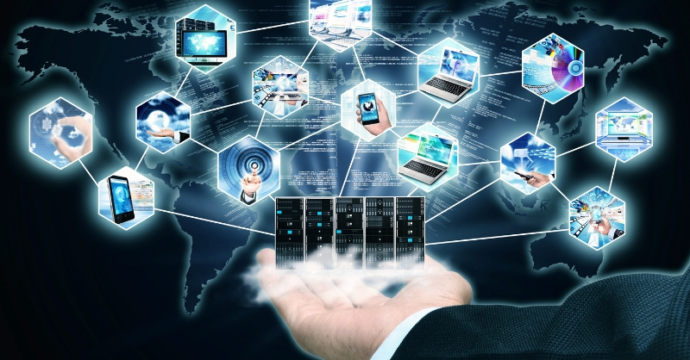
Case Studies & Examples
How ICT Improves Daily Work
The integration of ICT tools has fundamentally changed the modern professional landscape by replacing manual, time-consuming tasks with automated digital workflows
Enhanced Connectivity
Seamless Collaboration
Data-Driven Efficiency
Workflow Flexibility

Slide 13
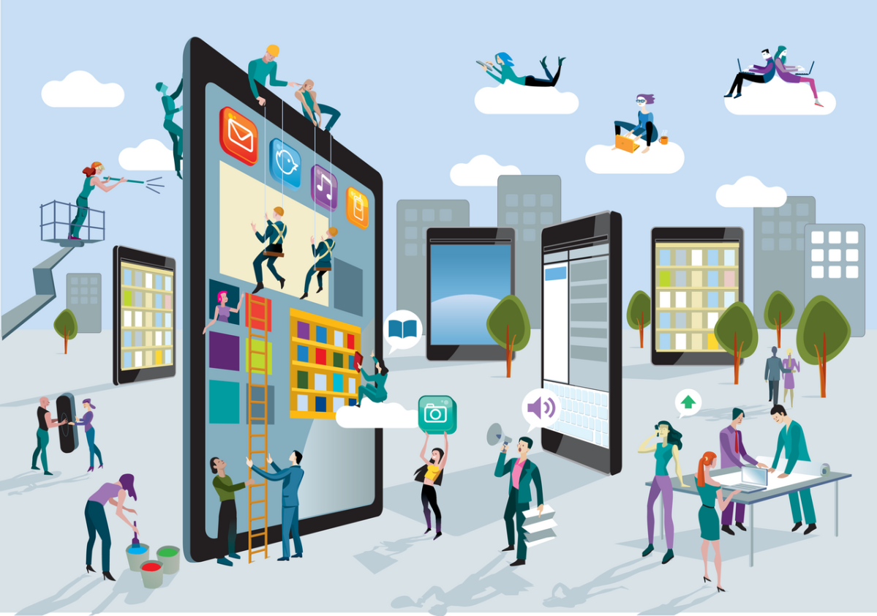
Real-World Applications
ICT is not limited to office work; it has revolutionized every major sector of the global economy:
Healthcare (Telemedicine & EHR): electronic health records Education (E-Learning Platforms): Google Classroom and Canvas
Finance (Digital Banking & Fintech): mobile banking apps, and automated fraud detection,
Software Engineering (DevOps): Git and GitHub

Slide 14
Conclusion
In conclusion, ICT has become an essential part of modern life rather than a luxury. Tools such as Google Workspace and Microsoft Office have transformed productivity and collaboration, while Git and GitHub have reshaped global project development. Overall, ICT forms a powerful ecosystem that connects people, drives innovation, improves efficiency, and will continue to be a key force in global progress and digital transformation.

